Slide 1

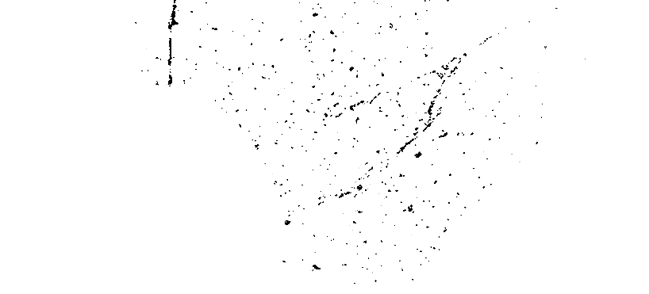
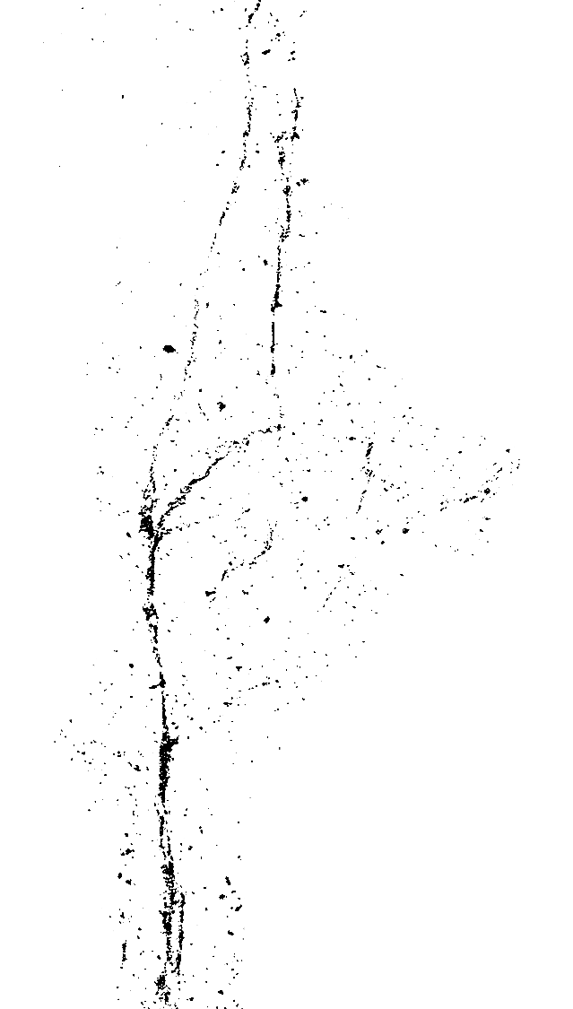
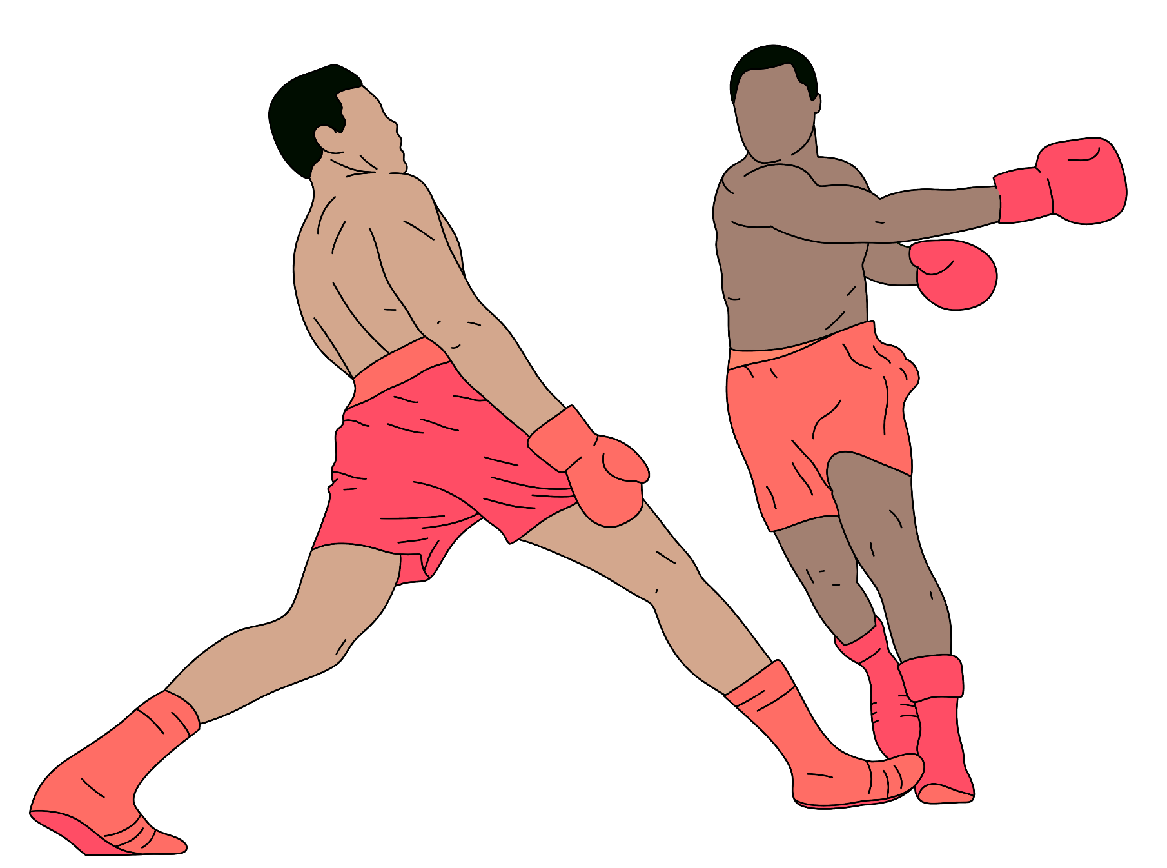


Batch- PGA-39
UFC Statistics Data Analysis
Presented By:
Kumar Rishikesh & Vansh Rathore
BOXING

Slide 2


Dataset: Ultimate Fighting Championship (ufc)
The Ultimate Fighting Championship (UFC) is a mixed martial arts (MMA) promotion company, known for organizing some of the most high-profile and exciting fights in the world of combat sports.
Through meticulous analysis and strategic scrutiny, this report aims to illuminate the inner workings of the UFC, providing stakeholders and enthusiasts with valuable insights.
By delving into the statistics, trends, and underlying dynamics of the UFC, stakeholders gain a deeper appreciation for the sport's complexity and potential avenues for growth and improvement.
Moreover, the report serves as a valuable resource for industry professionals, researchers, and enthusiasts seeking to navigate the ever-evolving landscape of combat sports. As the UFC continues to captivate audiences and expand its global reach.
By employing advanced data analytics tools and techniques this report offers invaluable insights into the inner workings of one of the most compelling sports phenomena of our time.

Slide 3
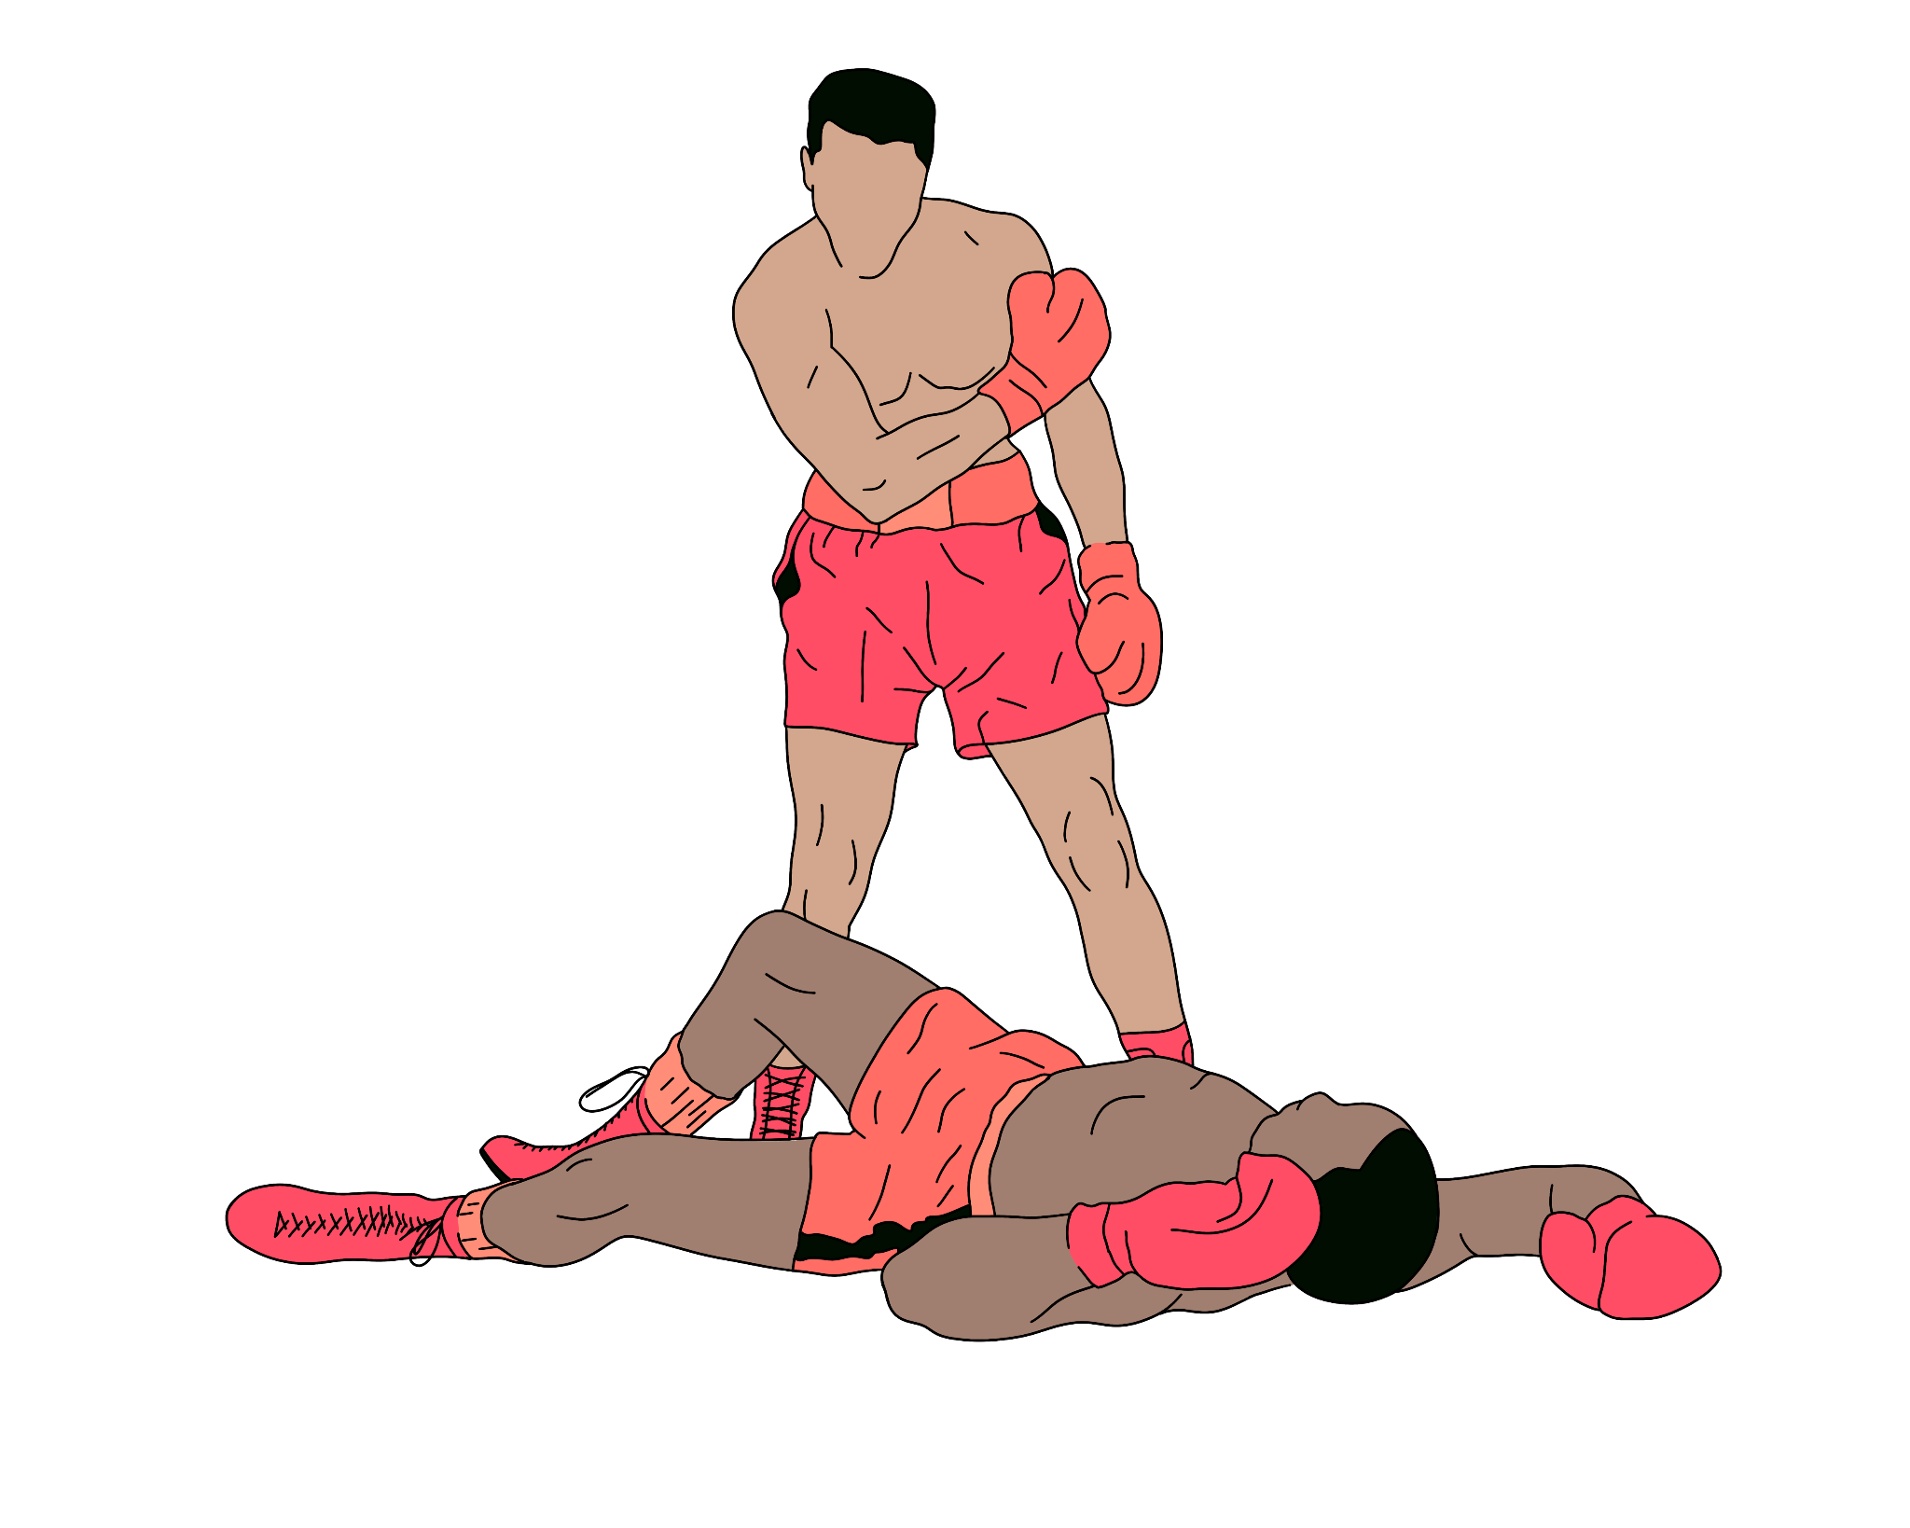
Problem Statement
UFC continues to expand its global reach and diversify its product offerings, understanding market dynamics and audience preferences becomes increasingly crucial. Without a nuanced understanding of these factors, stakeholders face uncertainty in decision-making, potentially leading to missed opportunities and suboptimal outcomes.
Our goal is addressing these challenges through rigorous analysis and strategic insight, stakeholders can gain a deeper understanding of the UFC's operations and leverage data-driven approaches to navigate the complexities of the combat sports landscape effectively.

Slide 4
Data Discrepancies
TABLE_NAME | TOTAL ROWS | NULL VALUES | IMPUTATIONS | DUPLICATES | TRANSFORMATIONS/DELETIONS
UFC_FIGHT DATA | 7218 | 109 in Six columns | Replaced Null with 0 Dropped Null Values | 0 | Dropped Null Values Fixed Data-Types
UFC EVENT DATA | 665 | 49 in event_state | Filled with ‘’ ‘unknown’ | 0 | Fixed Date Data Type
UFC_FIGHTER DATA | 4107 | 452 in Eleven columns |  | 0 | Extracted Age from DOB.
UFC FIGHTER STAT DATA | 14436 | 9,427 in Eight Columns | Mode Average Default value | 0 | Fixed Data-Types

Slide 5
Feature Description
Table- ufc fight data
Fight_id | Unique ID identifying each fight
event_id | Unique ID identifying each event
referee | Name of the referee
f_1 | Fighter 1 ID
f_2 | Fighter 2 ID
winner | ID of the winner
num_rounds | Number of Rounds in a fight
title_fight | Title Of the Fight
weight_class | Division of Weight class
gender | Gender/Sex
result | Ending of the fight
result_details | Result in Details
finish_round | Round in which Fight got finished
finish_time | Duration of fight
fight_url | Link related to that Fight which refers to official page of UFC

Slide 6
Feature Description
Table- ufc event data
event_id | ID of the event
event_name | Name of the event
event_date | Date of the event
event_city | City Where Event was organised
event_state | State Where Event was organised
event_country | Country Where Event was organised
event_url | Official URL/link of the website related to that particular event.

Slide 7
Feature Description
Table- ufc fighter data
Fighter_id | Id of the fighter
fighter_f_name | Fighter first name
fighter_l_name | Fighter last name
fighter_nickname | Fighter nickname
fighter_height_cm | Fighter height in centimeters
fighter_weight_lbs | Fighter Weight in lbs
fighter_reach_cm | Distance between Tips of two arms of the fighter when arms are in horizontal position
fighter_stance | Fighter Stance
fighter_dob | Fighter date of birth
fighter_w | Fighter Wins
fighter_l | Fighter Loses
fighter_d | Fighter Draws
fighter_url | Url redirecting to the official profile page of the ufc fighter

Slide 8
Feature Description
Table- ufc fighter stat data
fight_stat_id | ID of Fight Stat
fight_id | ID of the fight
fighter_id | ID of the fighter
knockdowns | NO. of knockdowns
total_strikes_att | NO. of total Strikes Attempted
total_strikes_succ | NO. of total Strikes Succeeded
sig_strikes_att | NO. of significant Strikes Attempted
sig_strikes_succ | NO. of total Strikes Succeeded
takedown_att | NO. of Takedowns Attempted
takedown_succ | NO. of Takedowns Succeeded
submission_att | NO. of submissions Attempted
reversals | No. of reversals Attempted

Slide 9

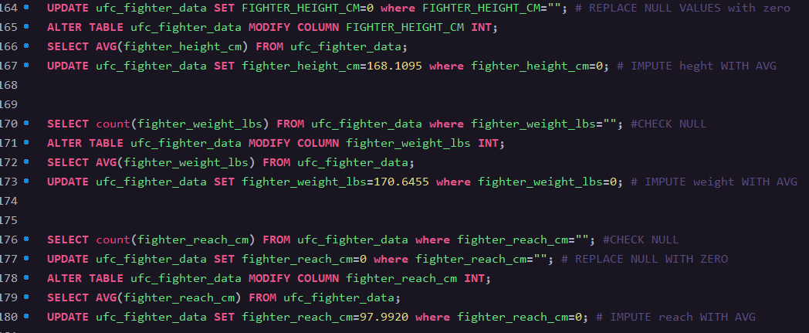
Data Preprocessing/Cleaning using MySQL
Replacing Null Values of height column and Imputing with avg height.
Replacing Null Values of height column and Imputing with avg height.
Replacing Null Values of fight reach and Imputing with avg.

Slide 10
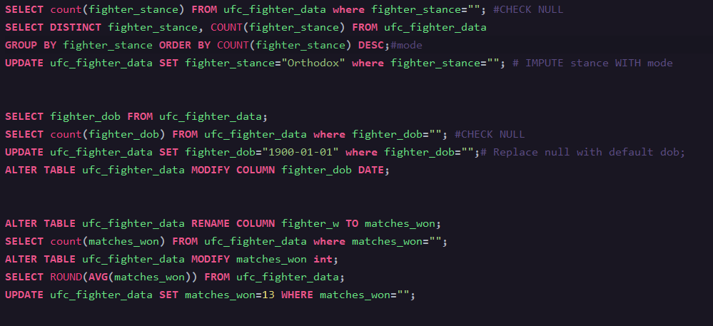
Data Preprocessing/Cleaning using MySQL
Imputing null values with mode i.e. most occurred value of the column.
Replacing Null Values in DOB column with default DOB.
Rename Column fighter_w to matches won.
Replace null with Avg number of wins.

Slide 11


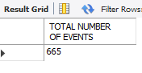
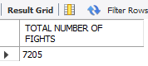
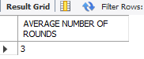
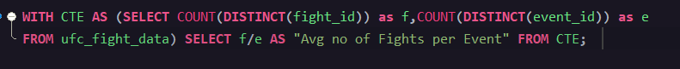
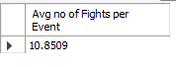
Key-Performance Indicators and Insights using SQL

Slide 12
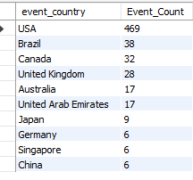
Key-Performance Indicators and Insights using SQL
Top 10 Country by number of Events held.

Slide 13
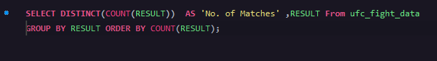
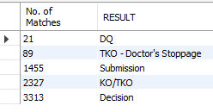
Key-Performance Indicators and Insights using SQL
Count of Result by Respective Finish Round

Slide 14
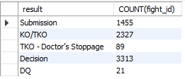
Key-Performance Indicators and Insights using SQL
Number Fights with respective end Result

Slide 15
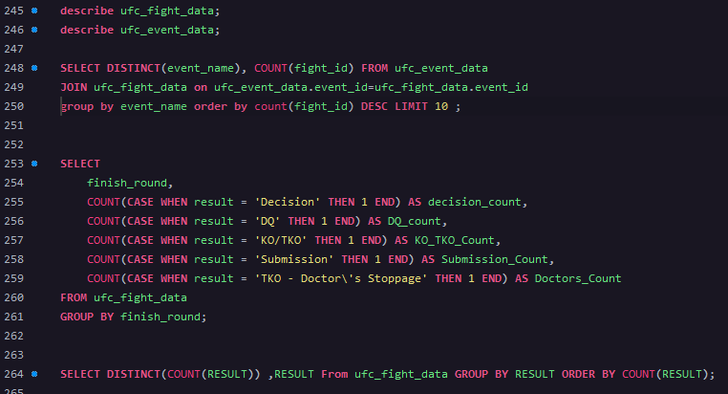
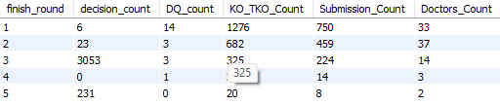
Key-Performance Indicators and Insights using SQL
Count of Result by Respective Finish Round

Slide 16
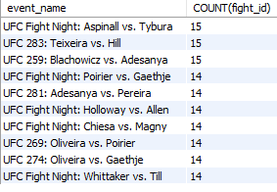
Key-Performance Indicators and Insights using SQL
Top 10 Events By Maximum Number of Fights

Slide 17
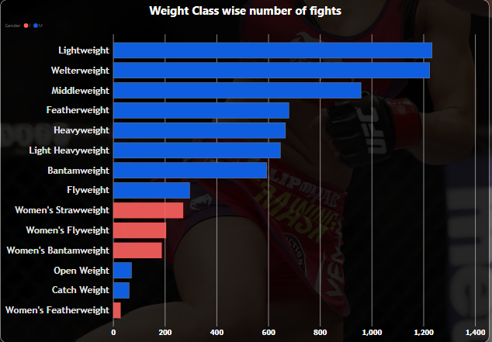
Power-Bi Dashboard Insights
UFC FIGHT STAT DATA
Weight class versus number of Fights.
This graph shows number of fights occurred in each weight category

Slide 18
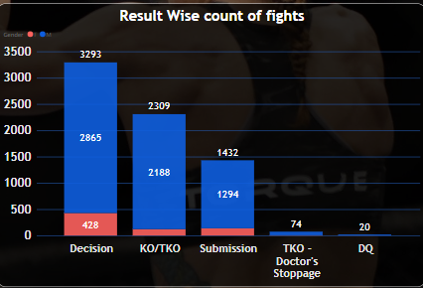
Power-Bi Dashboard Insights
UFC FIGHT STAT DATA
Result wise number of fights.
This graph shows number of fights occurred according to Result.

Slide 19
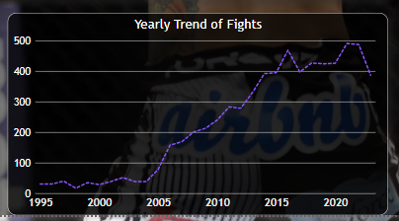
Power-Bi Dashboard Insights
UFC FIGHT STAT DATA
Year wise no. of fights.
The line graph depicts the trend of fights with time.
Significant Increase in Popularity can be seen.

Slide 20
Power-Bi Dashboard Insights
UFC FIGHT STAT DATA
Year wise no. of fights.
The line graph depicts the trend of fights with time.
Significant Increase in Popularity can be seen.

Slide 21
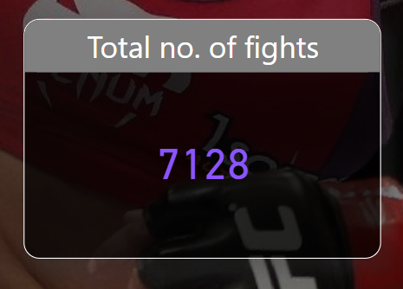
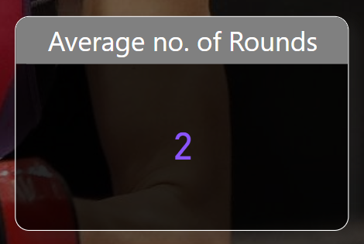
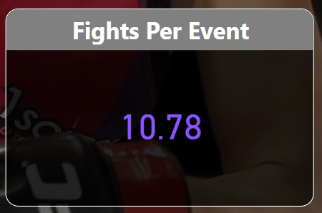
Power-Bi Dashboard
Key performance indicators
UFC FIGHT STAT DATA

Slide 22
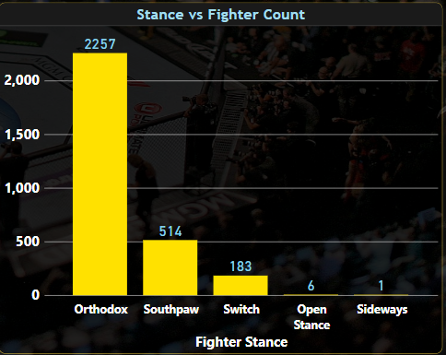
Power-Bi Dashboard
Key performance indicators
UFC FIGHTER STAT DATA
A fighter stance typically indicates whether a fighter predominantly fights in an orthodox stance (right-hand is closer to the opponent) or a southpaw stance (left-hand closer to the opponent).
1.Orthodox- Employed by Highest Number of fighters <2000 according to the data.
2.Southpaw- Employed by around 500 fighters.
3.Switch - Approximately 250 fighters have the ability to switch b/w orthodox and southpaw during the fight.
4.Sideways- Body is positioned more sideways relative to the opponent.

Slide 23
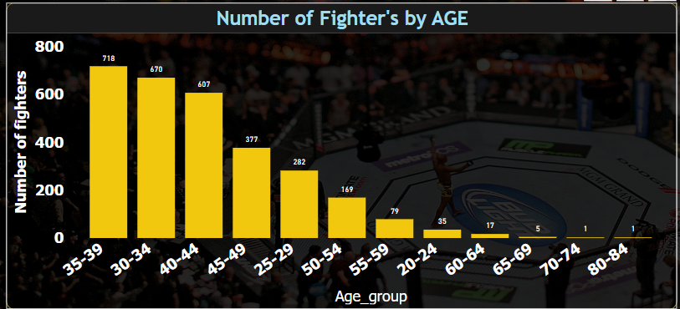
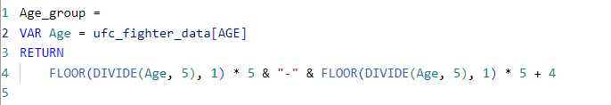
Power-Bi Dashboard
Key performance indicators
UFC FIGHTER STAT DATA

Slide 24
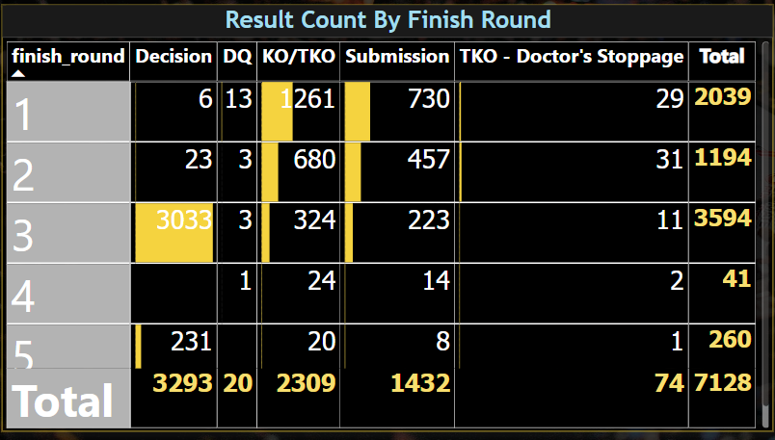
Power-Bi Dashboard
Key performance indicators
UFC FIGHTER STAT DATA

Slide 25
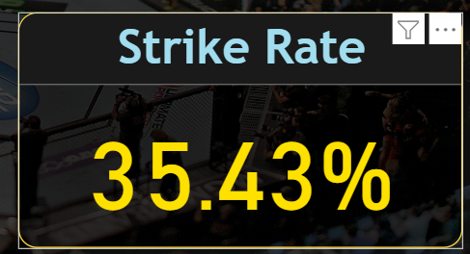
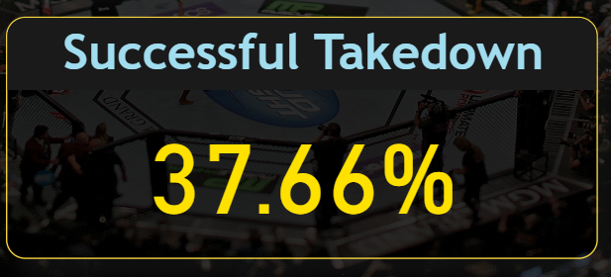
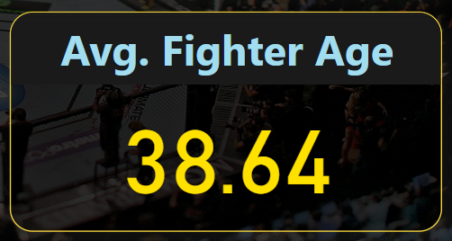
Power-Bi Dashboard
Key performance indicators
UFC FIGHT STAT DATA
Avg.Fighter Age= CALCULATE(SUM(ufc_fighter_data[Age])/COUNT(ufc_Fighter_data[Fighter_id]))

Slide 26
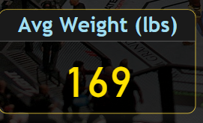
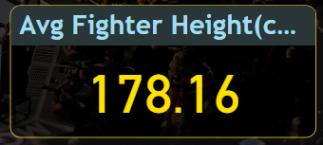
Power-Bi Dashboard
Key performance indicators
UFC FIGHT STAT DATA
Avg Weight(lbs)=CALCULATE(SUM(ufc_fighter_data[fighter_weight_lbs])/COUNT(ufc_Fighter_data[Fighter_id]))
Avg fighter height(cms)=CALCULATE(SUM(ufc_fighter_data[fighter_height_cms])/COUNT(ufc_Fighter_data[Fighter_id]))

Slide 27
Insights drawn from Fight Stat Dashboard:
Most of the fights occurred in UFC according to weight class is of Light weight class followed by WelterWeight class,MiddleWeight class and Featherweight class etc.
Most of the fights’ result in UFC is Decision result followed by KO/TKO,Submission etc.
From the year v/s no. of fights graph, it can be seen clearly that there an increasing trend of the fights which shows that UFC has gain much popularity in the past few years especially after 2004-2005. It can be also seen that after 2020 UFC has lost some of its popularity after late 2020.

Slide 28
Insights drawn from Fighter Stat Dashboard:
Most of the fighters in the Dataset have the Stance “Orthodox” followed by “southpaw”, “Switch” Etc.
Most of the fighters in the Dataset are in their Mid 40’s.
In the Pivot Table of fighter Stat Dashboard. It Gives us A little Summary Drawn between the result and n’th finish Round.

